Slide 1



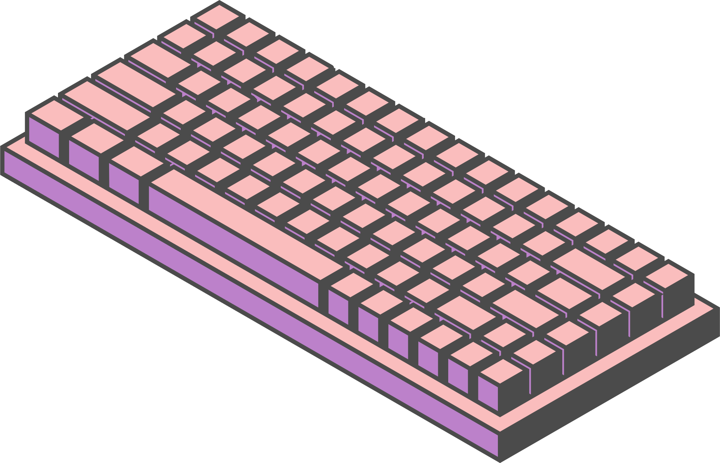
Home
Service
About us
Contact us
EVERYTHING DATA!
LET’S TALK PLOTS AND REPOSITORIES
Today, the group will happily share a moment speaking summaries and in-depth descriptions of CTEC 128 and CTEC 298 tasks.
by: Aaronea Wiggins + Lojain Idris
Page 01

Slide 2



HOME
SERVICE
ABOUT US
CONTACT US
INTRODUCTION
Hi everyone,
I’m Aaronea Wiggins and Lojain Idris.
We are both active participants within course
CTEC 298 session 2.
Page 02

Slide 3



AW
HOME
SERVICE
ABOUT US
CONTACT US
SUMMARIES
OF CTEC 128
PREVIOUSLY IN CTEC
GATHERED DATA
OVERALL STUDY
what data you asked?
my group was able to retrieve stats directly from the FBI website in relation to the number of crimes that occurred in 2020, grouped by race.
our overall discovery was that Pacific Islanders and White Americans have committed the most crimes.
I worked with a group of four
and together we gathered data.
Page 03

Slide 4
LI
HOME
SERVICE
ABOUT US
CONTACT US
SUMMARIES
OF CTEC 128
PREVIOUSLY IN CTEC
TOPIC
TOPIC
Top Data Breaches (2004-2021)
Focuses on the the growing global threat of cyber-attacks to businesses
Identifies common types of cyber-attacks.
Analyzes the average number of attacks each year(2004-2021)
Pivot table to show how different organization types were affected over time
provide useful insights for developing better cybersecurity strategies.
Page04

Slide 5
CH
HOME
SERVICE
ABOUT US
CONTACT US
SUMMARIES
OF CTEC 128
PREVIOUSLY IN CTEC
TOPIC
TOPIC
type
type
type
Page 05

Slide 6


AW
HOME
SERVICE
ABOUT US
CONTACT US
DESCRIPTION
CTEC 298 MATERIAL
During my time within this course
I have been introduced to many data related tutorials and tasks.
CTEC 298 has exposed the class to data software and repositories such Matplotlib, Jupyter Notebook, Tableau, and GitHub.
DEFINITIONS
·Jupyter Notebook is an interactive notebook which integrates code, visualizations, equations, and more. File extension .ipynb
Matplotlib: A comprehensive library for creating static, animated, and interactive visualizations in Python
Tableau: software for data input, visual analytical tool to help understand data
GitHub: considerable repository to manage and share code.
I have imported and uploaded several files within my repositories utilizing CTEC 128’s data.
Page 06

Slide 7

LI
HOME
SERVICE
ABOUT US
CONTACT US
DESCRIPTION
CTEC 298 MATERIAL
LearnPython Tutorials Part One.
LearnPython Tutorials Part Two
Anaconda Installation
GItHub Account Set Up
Matplotlib Tutorials
Matplotlib Python Plotting
Pandas Tutorials
Tableau Tutorials
Jupyter Notebook Python Code Completion
Page 07

Slide 8
CH
HOME
SERVICE
ABOUT US
CONTACT US
DESCRIPTION
CTEC 298 MATERIAL
type
type
Page 08

Slide 9

AW
HOME
SERVICE
ABOUT US
CONTACT US
DESCRIPTION
OF CTEC 298 PLOT(S)
Of the six plots that we had to code, I’d easily say the bar graph was less tedious to complete within my Jupyter notebook.
During our individual plot assignment, I was assigned the Histogram that is a great plot for stats!
Page 09

Slide 10
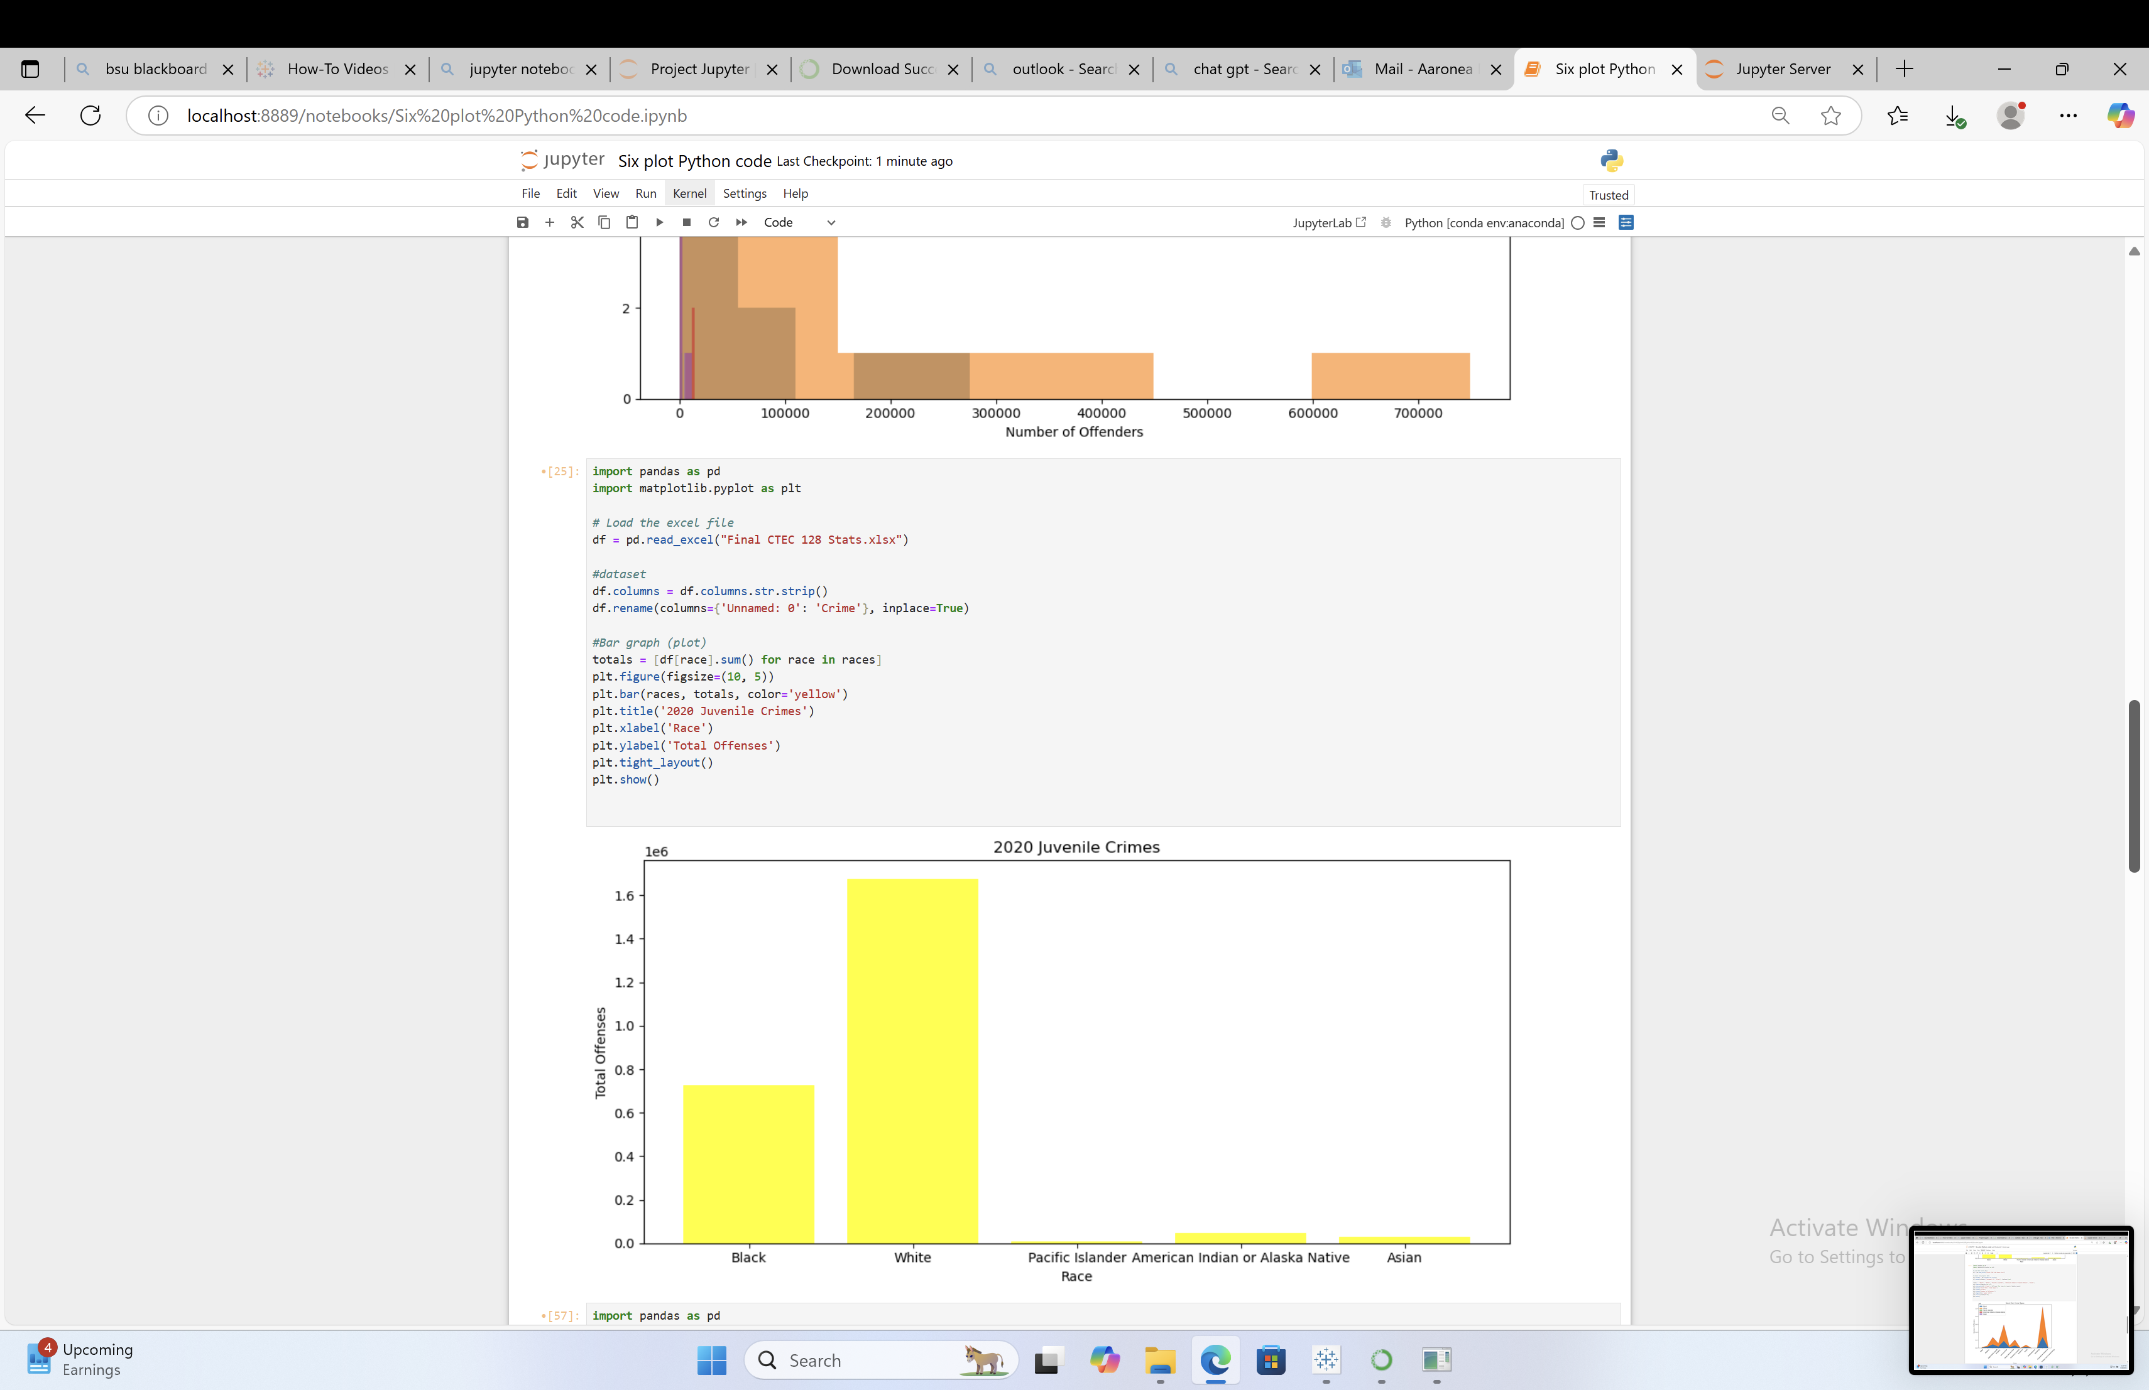
Bar Plot
AW
HOME
SERVICE
ABOUT US
CONTACT US
VISUALS – JUPYTER NB
OF CTEC 298 PLOT(S)
Page 09

Slide 11
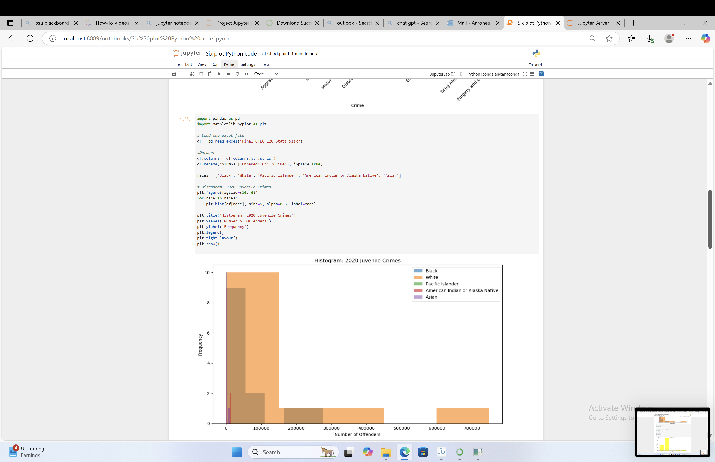
Histogram plot
AW
HOME
SERVICE
ABOUT US
CONTACT US
VISUALS – JUPYTER NB
OF CTEC 298 PLOT(S)
Page 09

Slide 12
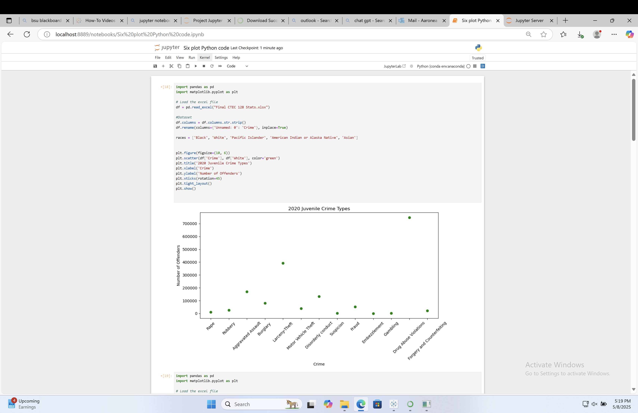
Scatter plot
AW
HOME
SERVICE
ABOUT US
CONTACT US
VISUALS – JUPYTER NB
OF CTEC 298 PLOT(S)
Page 09

Slide 13
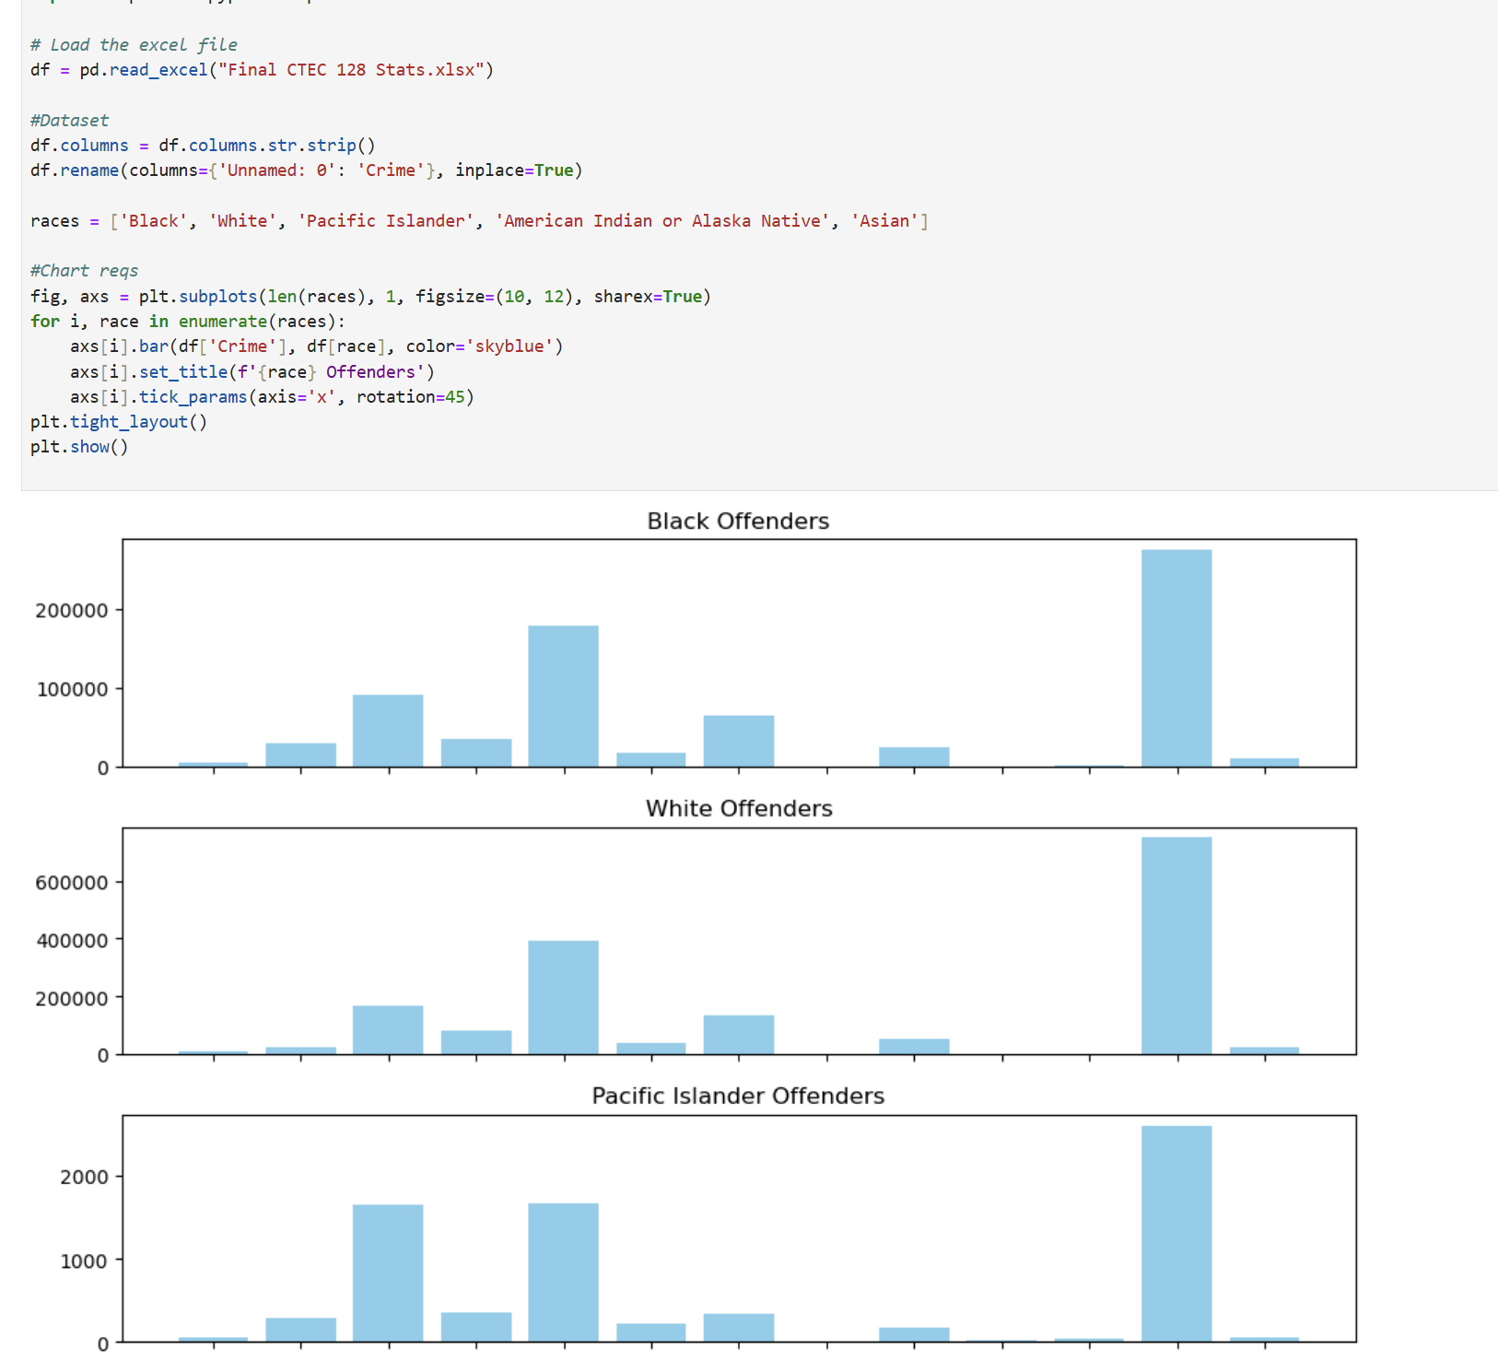
AW
HOME
SERVICE
ABOUT US
CONTACT US
VISUALS – JUPYTER NB
OF CTEC 298 PLOT(S)
Multi-Plot
Page 13

Slide 14
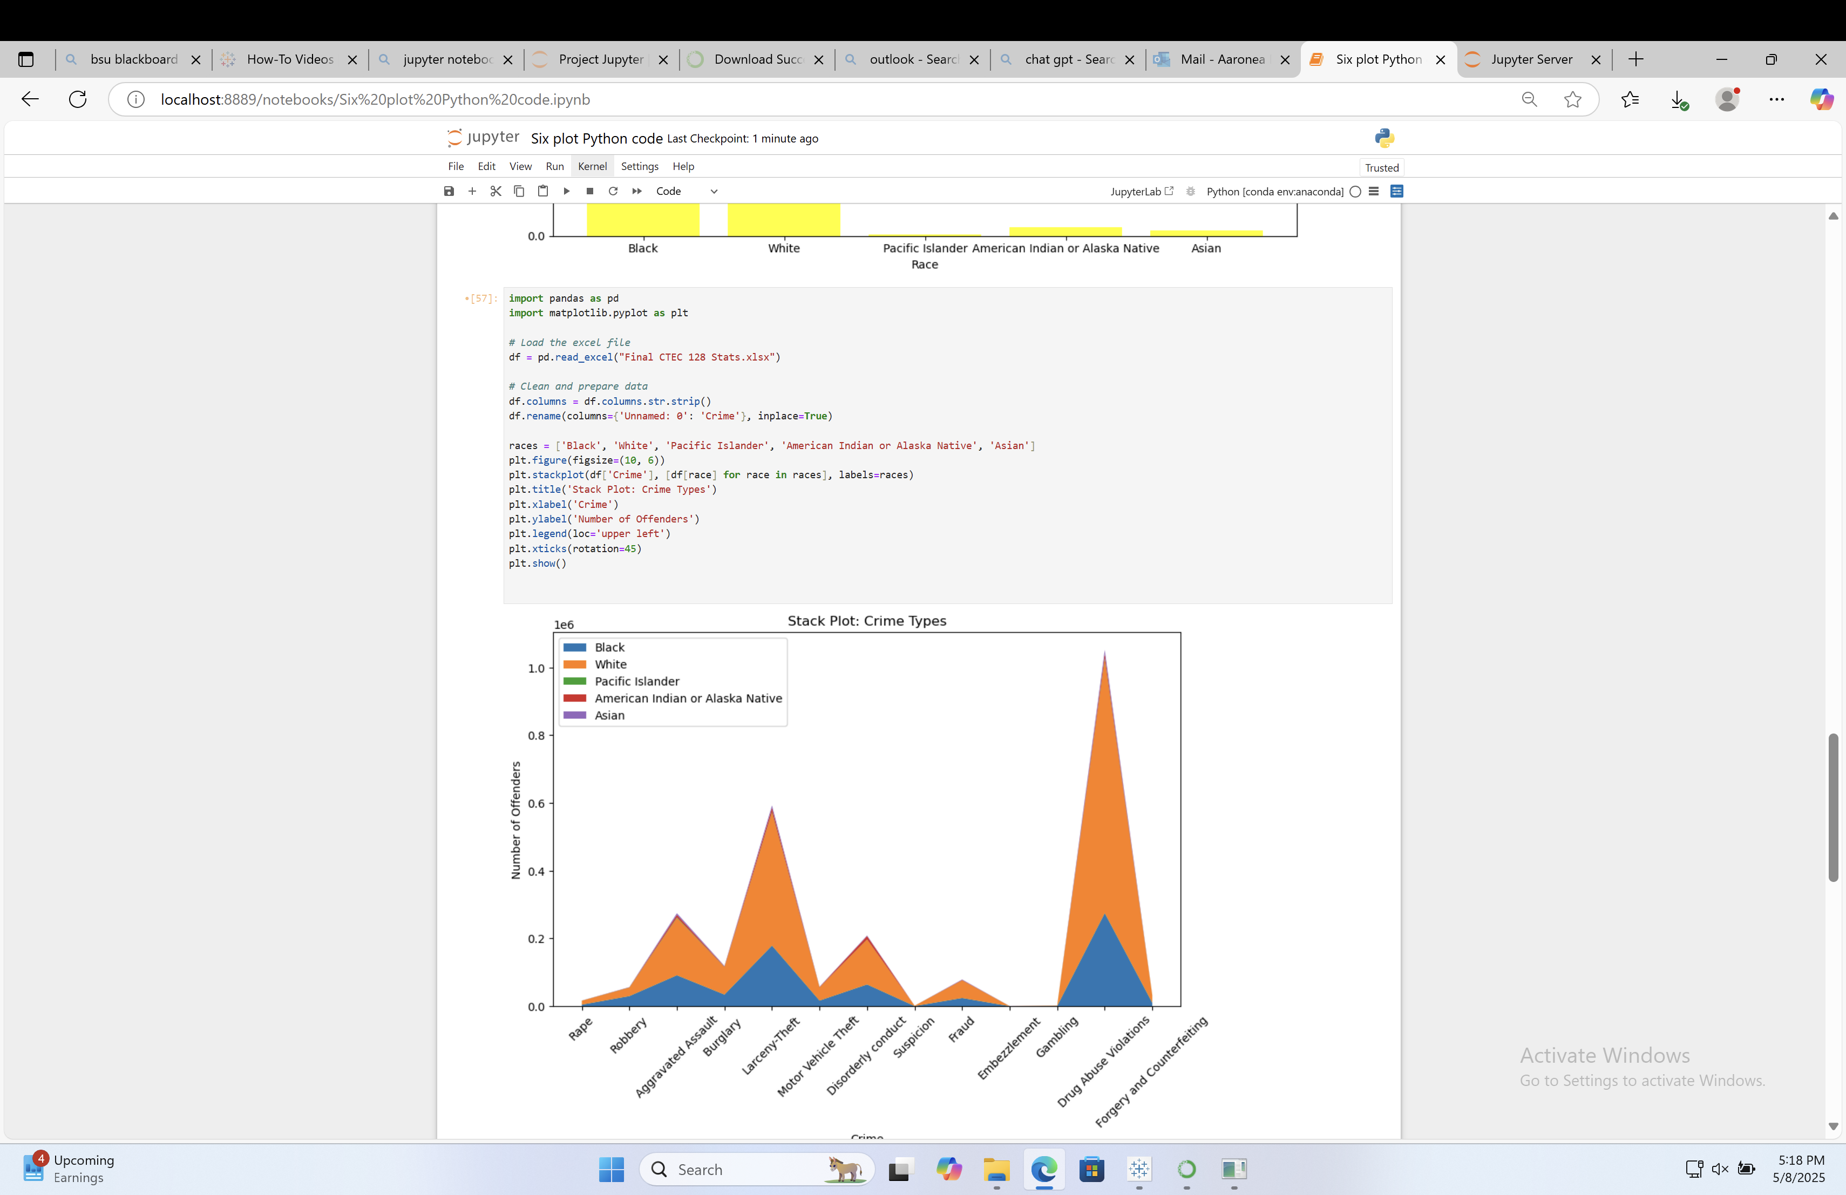
AW
HOME
SERVICE
ABOUT US
CONTACT US
VISUALS – JUPYTER NB
OF CTEC 298 PLOT(S)
Stacked Plot
Page 14

Slide 15
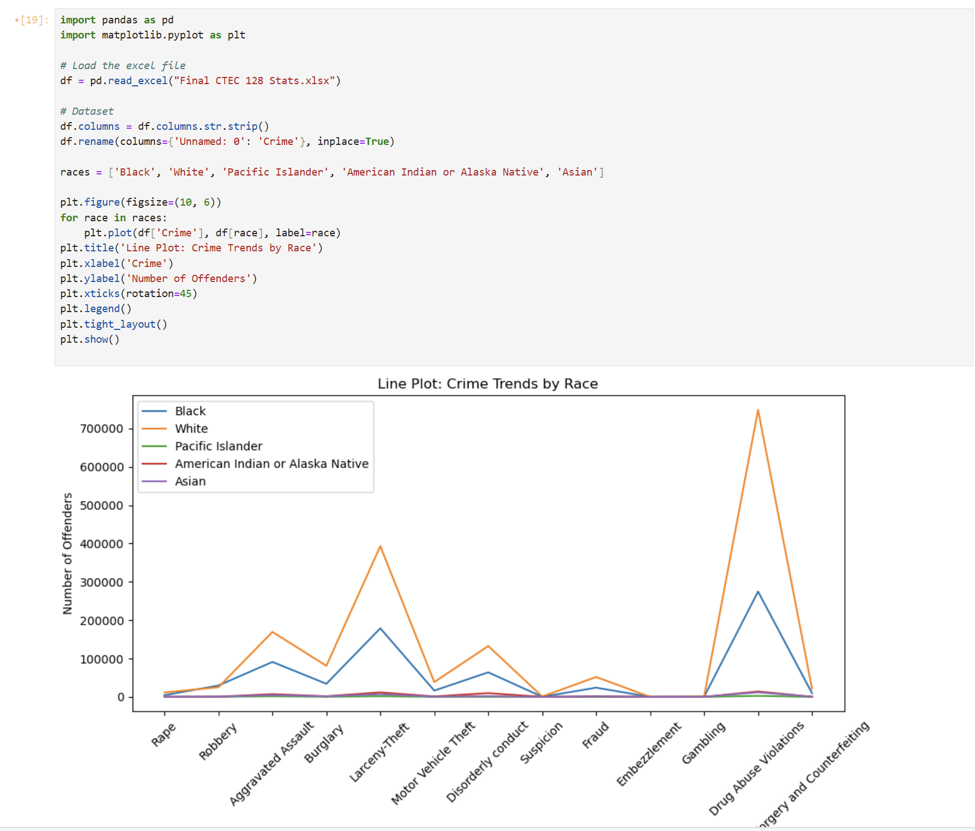
Line Plot
AW
HOME
SERVICE
ABOUT US
CONTACT US
VISUALS – JUPYTER NB
OF CTEC 298 PLOT(S)
Page 09

Slide 16
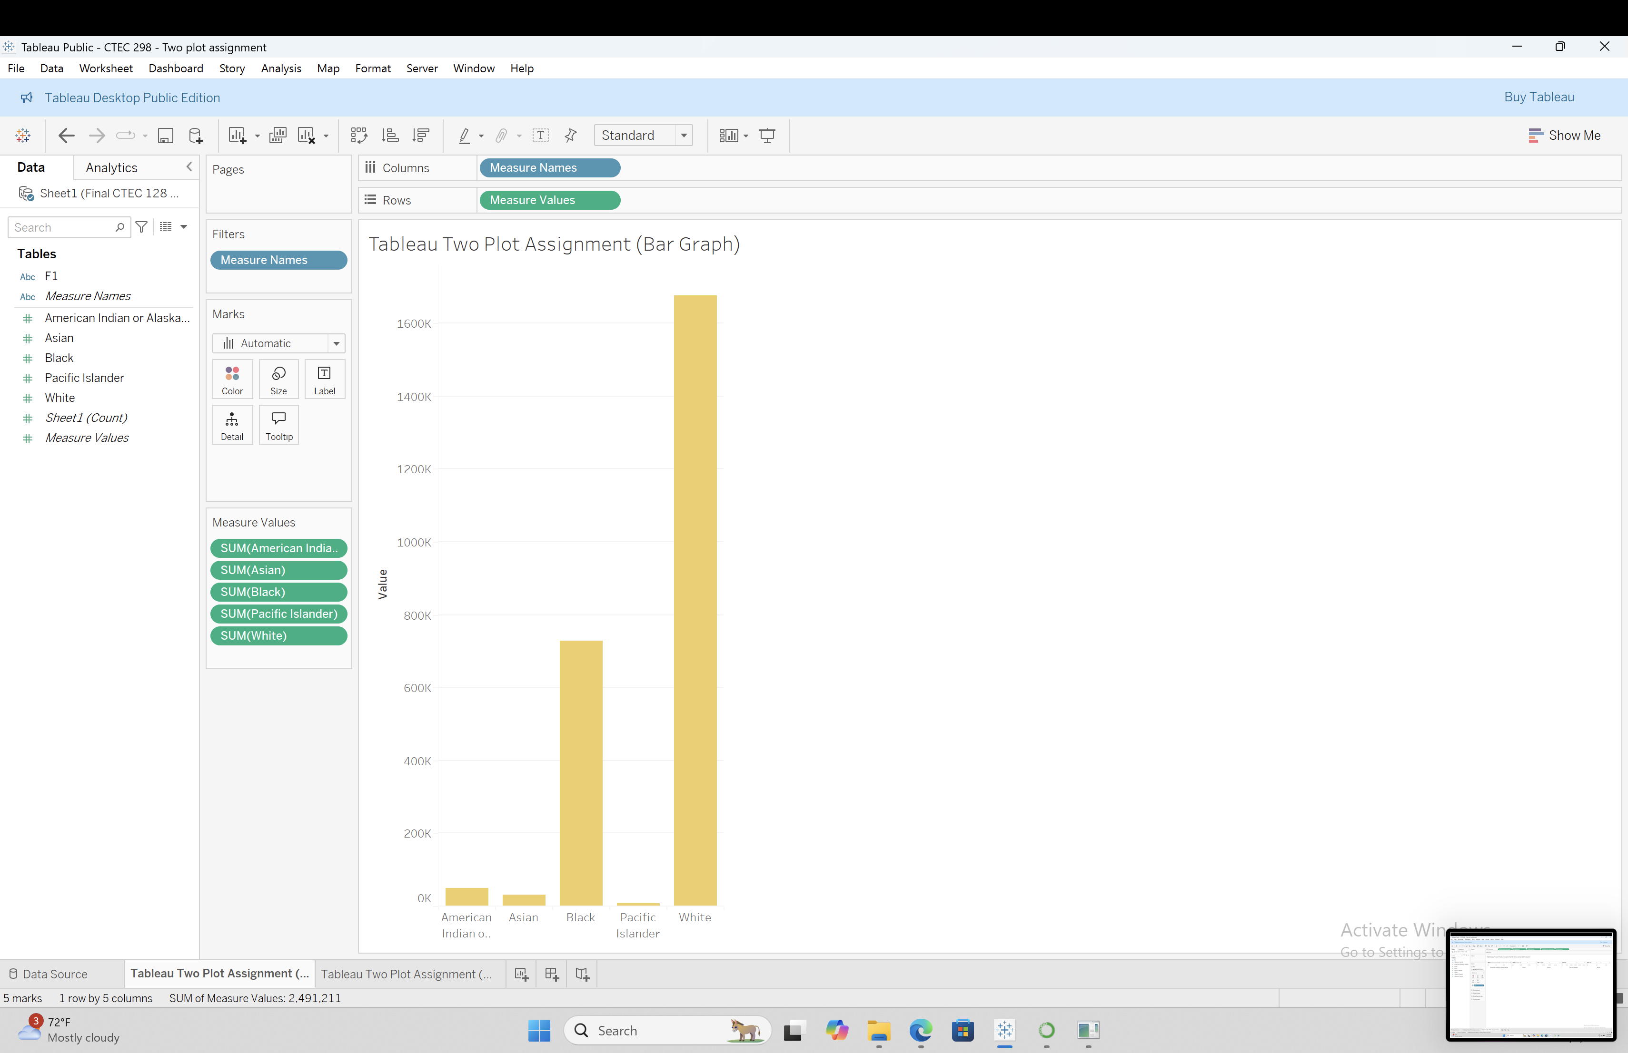
AW
HOME
SERVICE
ABOUT US
CONTACT US
VISUALS – TABLEAU
PLOT(S)
Bar Plot
Page 16

Slide 17
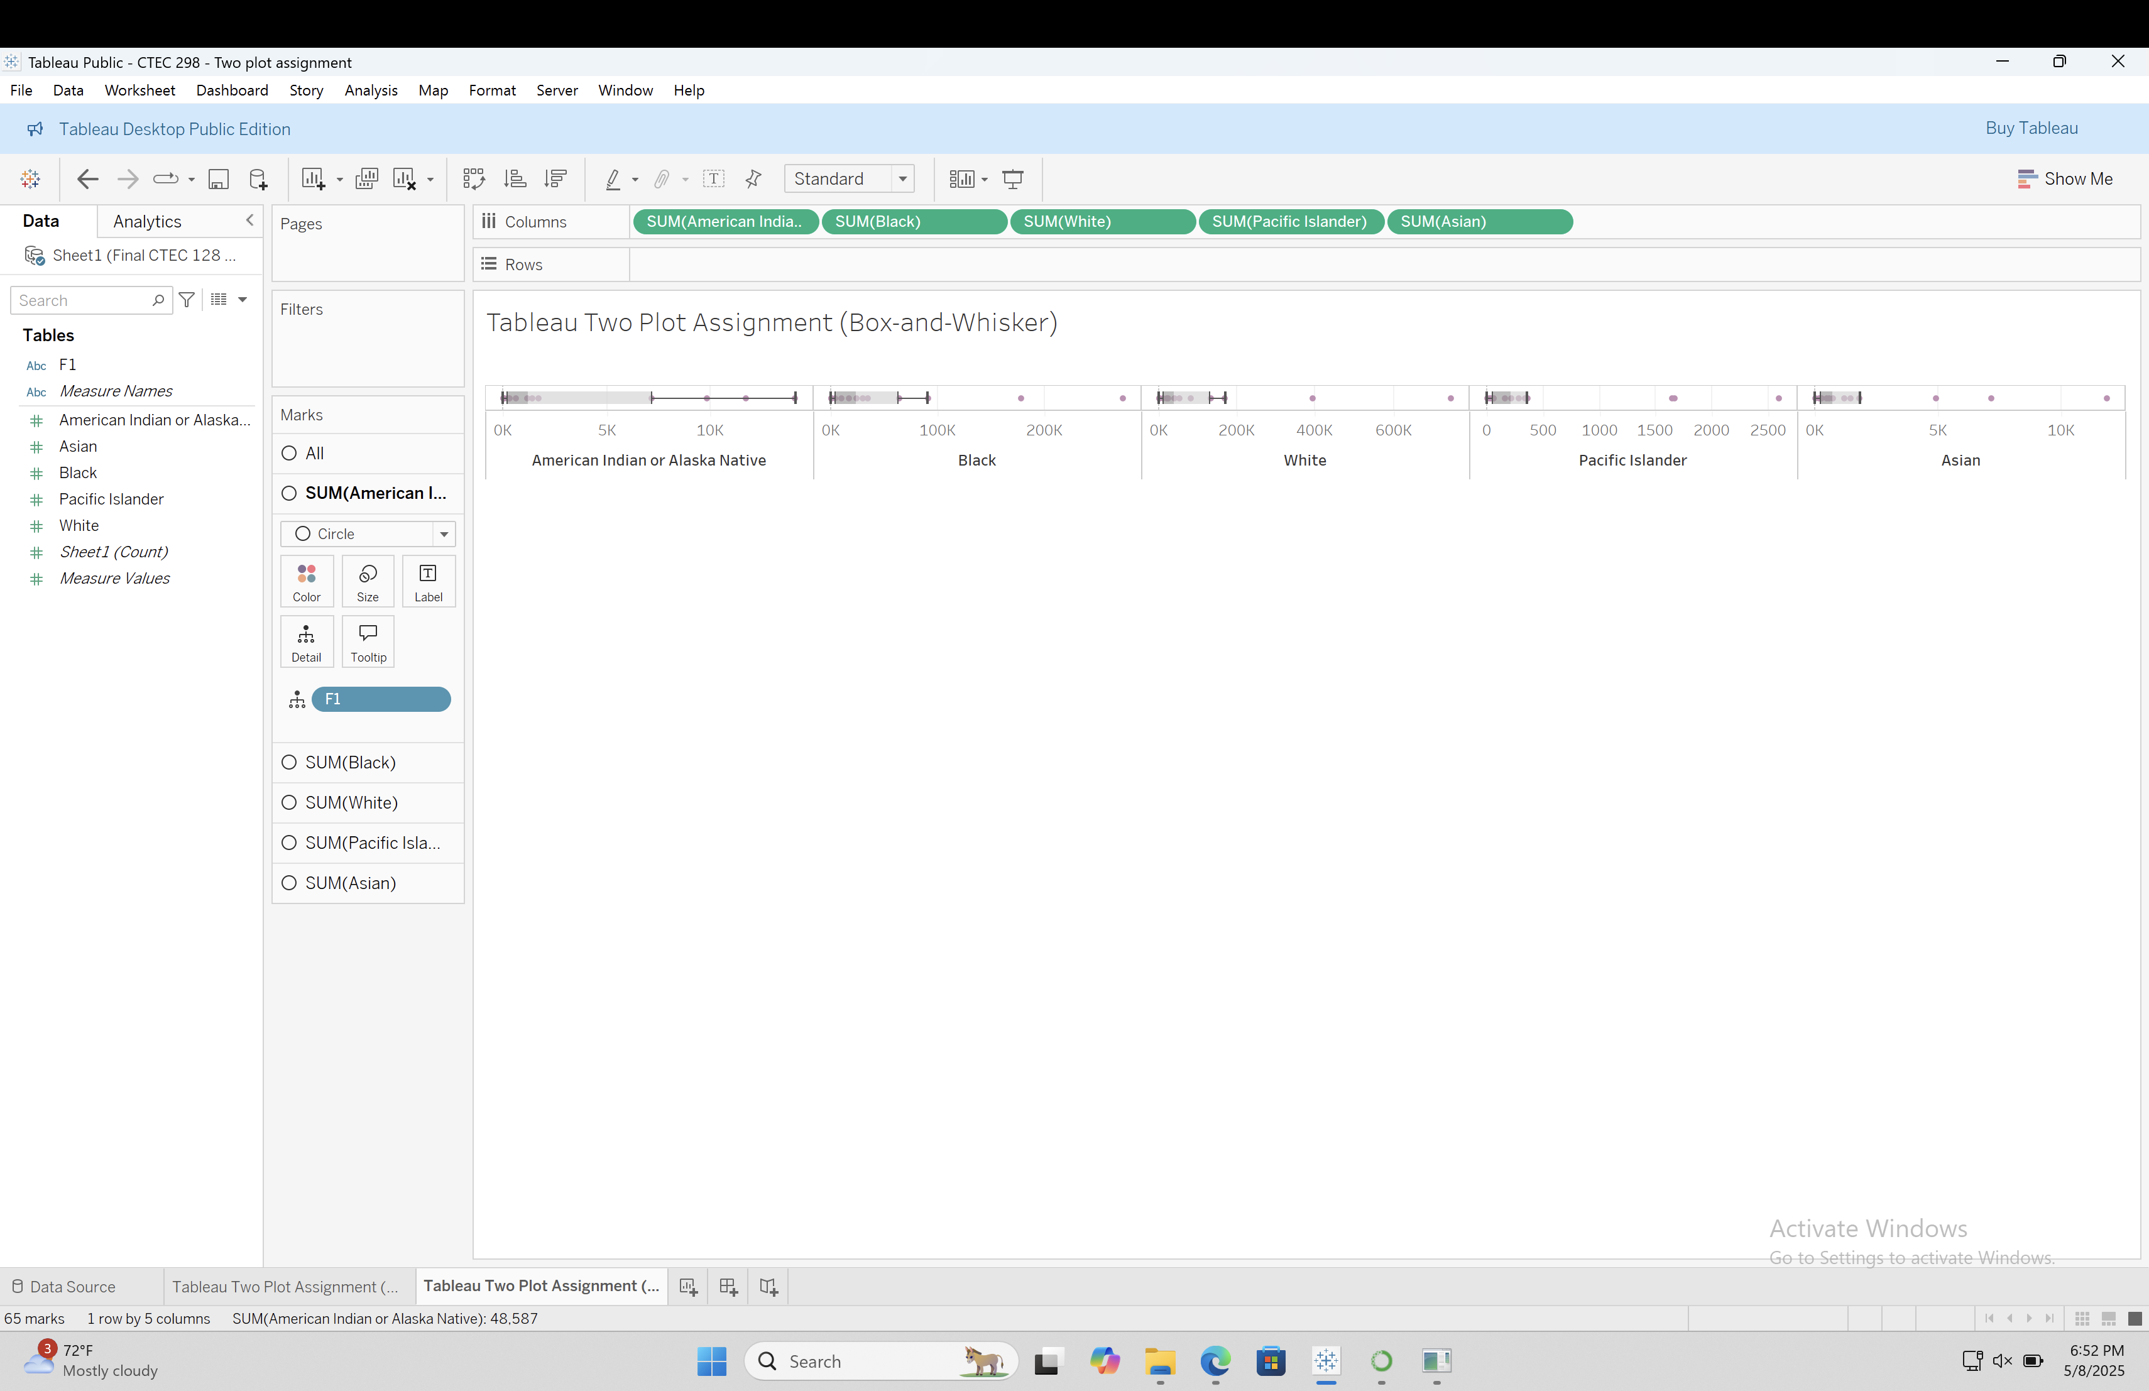
AW
HOME
SERVICE
ABOUT US
CONTACT US
VISUALS – TABLEAU
PLOT(S)
BOX-and-WHISKER
Page 1

Slide 18
LI
HOME
SERVICE
ABOUT US
CONTACT US
DESCRIPTION
OF CTEC 298 PLOT(S)
Matplotlib Pie Chart
Shows top 5 breached organization types
Each slice shows % of total breaches
Matplotlib Histogram
Shows how many records were breached in General
Bars are orange with black edges
Matplotlib Scatter Plot
Shows breaches from 2004 to 2021
Each yellow dot shows one breach
Matplotlib Bar Graph
Shows top 10 companies or groups with biggest breaches
Red bars show number of records breached
Matplotlib Area Plot
Shows total breaches each year (2004–2021)
Shows how breaches increased or decreased
Matplotlib Hexagonal Bin Plot
Shows where breaches were most common by year and record count
Fixed data by changing years to numbers
Tableau Packed Bubble Chart
Shows breach methods using bubbles
Bigger bubbles = more records affected
Tableau Horizontal Bar Chart
Shows total records breached by method
Longer bars = more records lost
Page 10

Slide 19
LI
HOME
SERVICE
ABOUT US
CONTACT US
VISUALS
OF CTEC 298 PLOT(S)
Matplotlib Pie Chart
Shows top 5 breached organization types
Each slice shows % of total breaches
Matplotlib Histogram
Shows how many records were breached in General
Bars are orange with black edges
Matplotlib Scatter Plot
Shows breaches from 2004 to 2021
Each yellow dot shows one breach
Matplotlib Bar Graph
Shows top 10 companies or groups with biggest breaches
Red bars show number of records breached
Matplotlib Area Plot
Shows total breaches each year (2004–2021)
Shows how breaches increased or decreased
Matplotlib Hexagonal Bin Plot
Shows where breaches were most common by year and record count
Fixed data by changing years to numbers
Tableau Packed Bubble Chart
Shows breach methods using bubbles
Bigger bubbles = more records affected
Tableau Horizontal Bar Chart
Shows total records breached by method
Longer bars = more records lost
Page 10

Slide 20
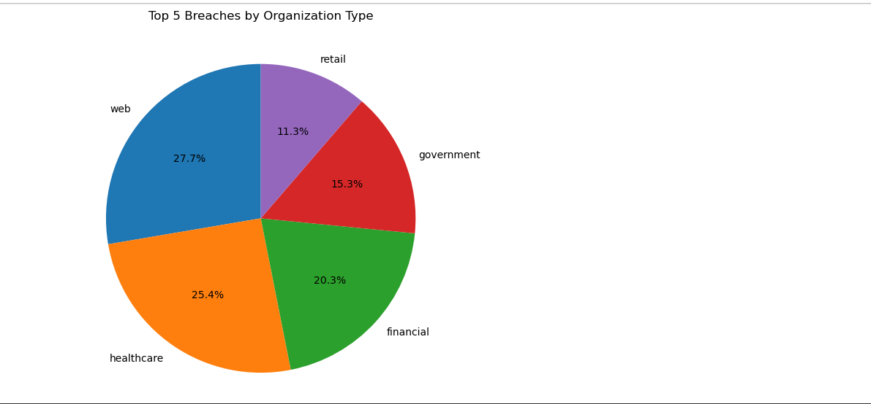
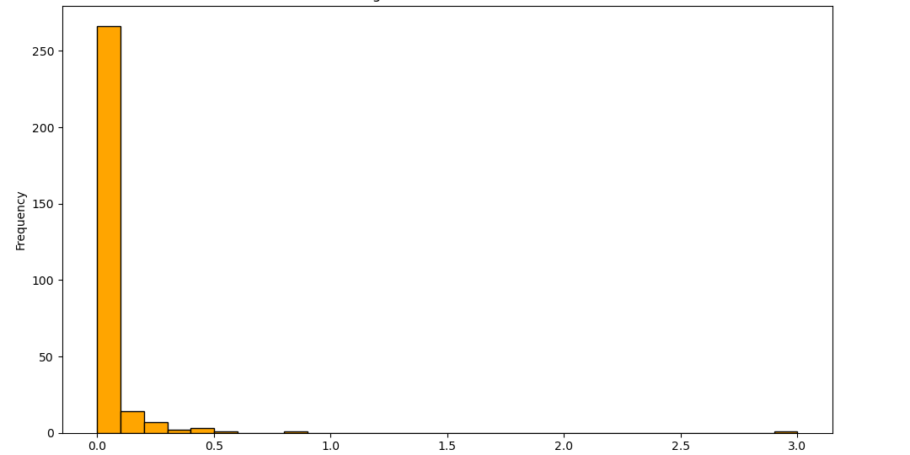
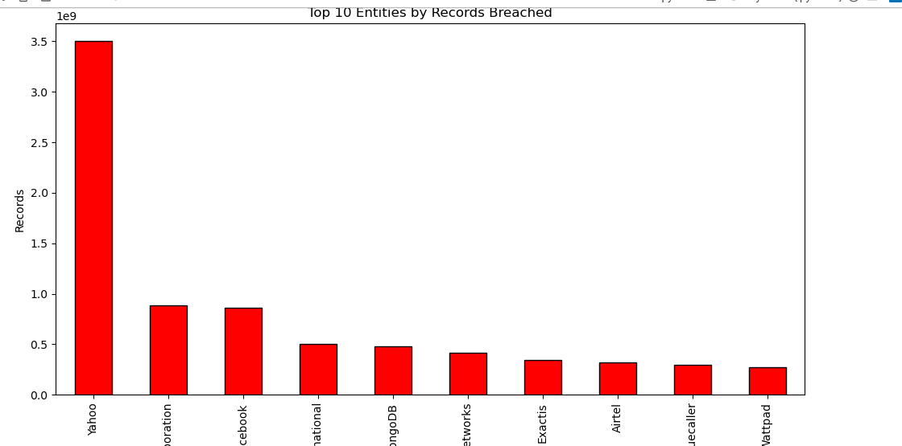
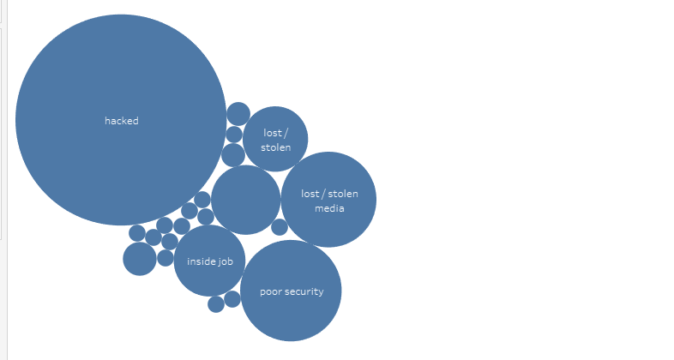
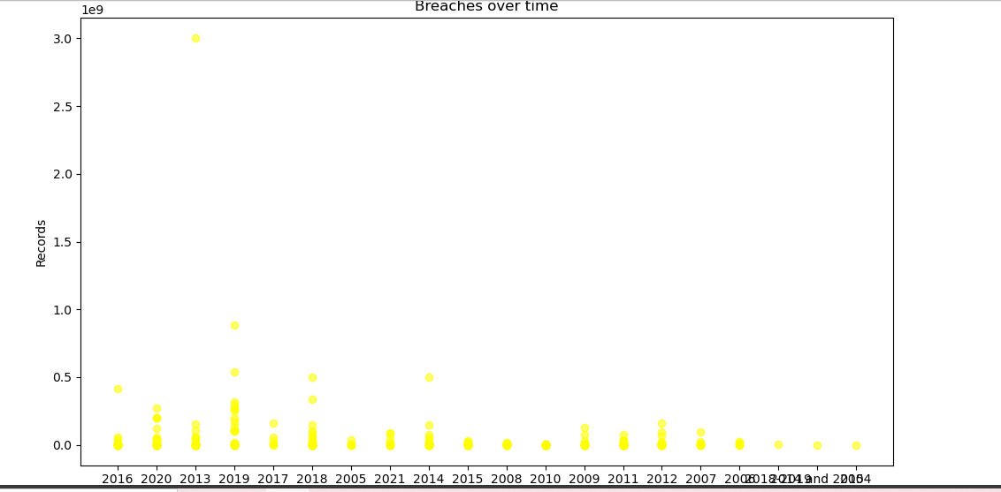
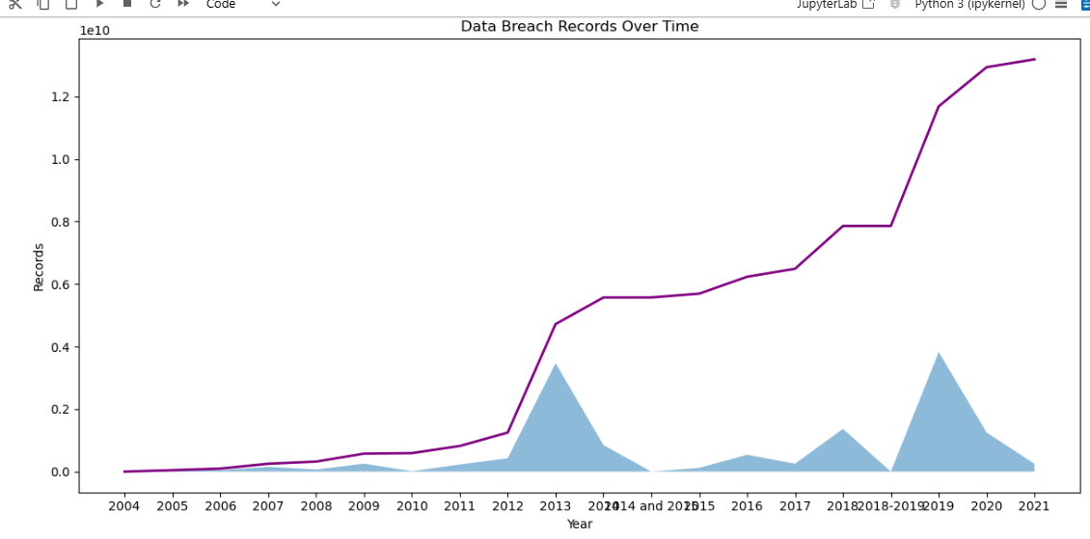
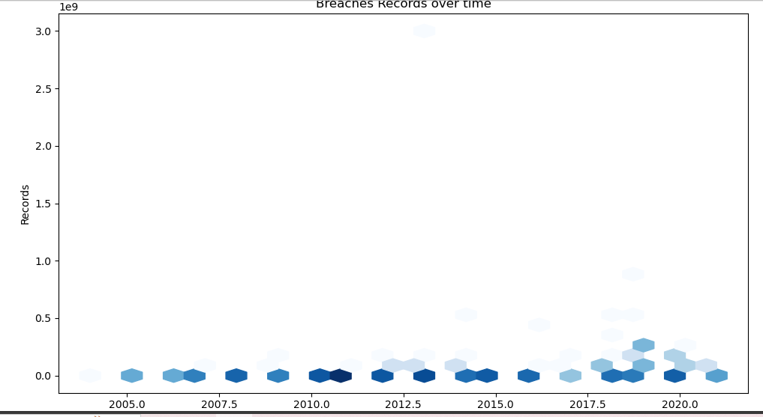
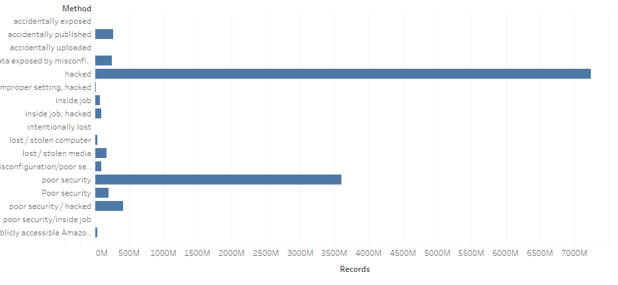
LI
HOME
SERVICE
ABOUT US
CONTACT US
DESCRIPTION
OF CTEC 298 PLOT(S)
Page 11

Slide 21
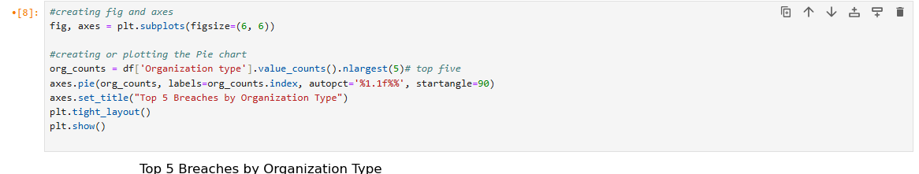

Slide 22
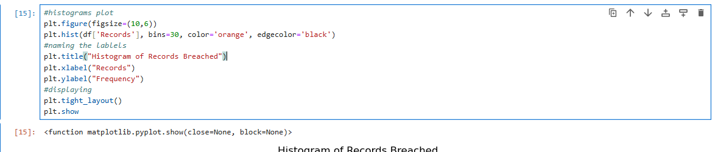

Slide 23
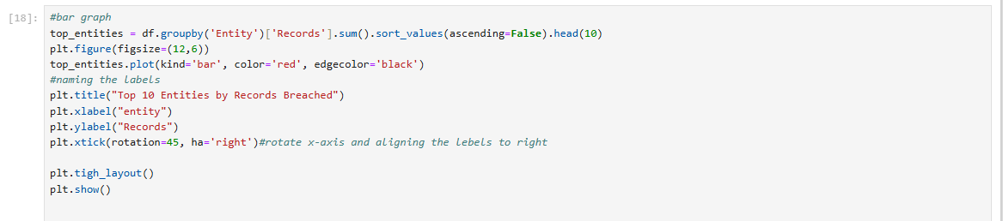

Slide 24
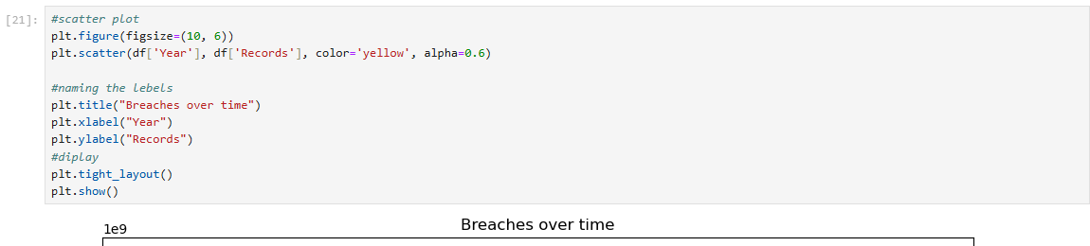

Slide 25
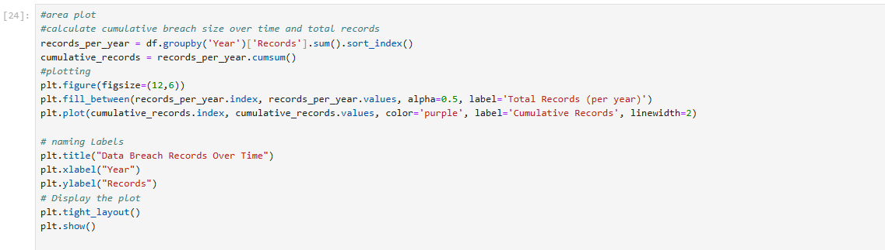

Slide 26
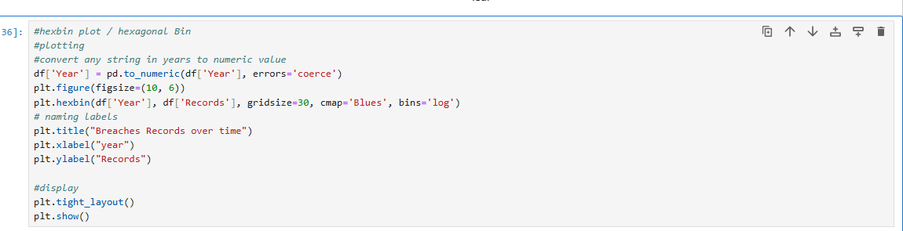

Slide 27
Tableau Plots Packed Bubble

Slide 28
Horizontal Bar

Slide 29



AW | LI
HOME
SERVICE
ABOUT US
CONTACT US
CONCLUSION:
This project has been a series of planned tasks with an objective, often involving multiple steps. It was be carried out by multiple individuals that formed or a team and was designed to achieve the specified outcome within a set timeframe (today). This class has taught us punctuality, how to data—visually, via code, and with teamwork
Page 29

Slide 30



AW | LI
HOME
SERVICE
ABOUT US
CONTACT US
REFERENCES
Arrests by offense, age, and race | Office of Juvenile Justice and Delinquency Prevention. (n.d.). https://ojjdp.ojp.gov/statistical-briefing-book/crime/faqs/ucr_table_2 – filtered by age/year
Top Data Breaches (2004-2021)
https://www.kaggle.com/datasets/hishaamarmghan/list-of-top-data-breaches-2004-2021
PAGE 30

Slide 31





AW | LI
HOME
SERVICE
ABOUT US
CONTACT US
THANK YOU
Bowie State University
Aaronea Wiggins
Lojain Idris
Page 31

